Slide 1
Cost of Delay – Policy and Prioritization Template
Example – ER Triage of Patients
Credits
Developed with & by PraxisFlow – www.praxisflow.com
Concept by Cat Swetel (@catswetel), Jabe Bloom (@cyetain), Troy Magennis (t_magennis)
Template design by Rashida Prattis (@RashidaDesigner)
Draws heavily on work by Joshua Arnold (@joshuajames) and Ozlem Yuce (@OzzieYuce) – www.BlackSwanFarming.com

Slide 2
To do -
The Goal:
All work grouped into one of three buckets
Work within the “Gold” and “Blue” bucket ordered by approximate Cost of Delay
Work in the first THIRD of the blue bucket quantitatively ordered by Cost of Delay
Facilitation style is up to you:
In-person: Print, discuss and sort paper (then re-order slides in this deck)
Remote: Online, discuss and re-order slides within the colored group placeholders

Slide 3
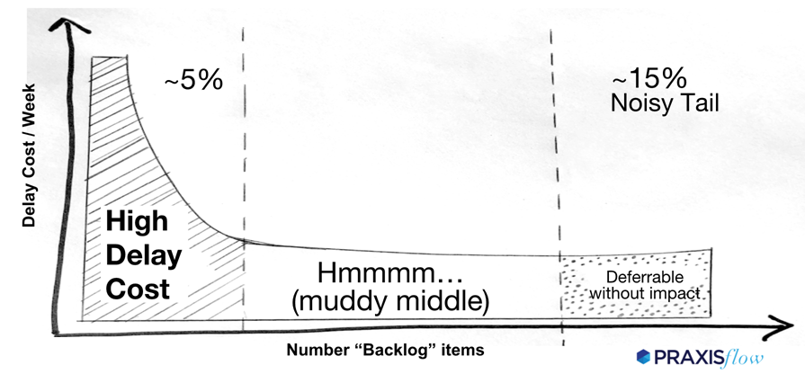
Deliverables
1. Bucket work into one of the three zones
2. Comparatively Order work
3. Calculate Cost of Delay / week for 1/3 middle

Slide 4
General facilitation
Lo-Fidelity Categorization Process
Describe the three Qualitative Cost of Delay groupings and define policy
Read through the projects listed in “not ordered or grouped” (grey) slide; Confirm understood.
Create an missing projects or other work this group knows it needs to do
As a group, move the work into one of the three groupings, Gold, Blue, or Green
As a group, agree on relative cost of delay to each other
Detailed Cost of Delay (for first THIRD of the “Blue” items only)
For the first THIRD of the blue group, fill in the details of the work canvas
Calculate and explain how you computed the Cost of Delay numerically and order

Slide 5
Facilitation Guide - Printed Process
Describe the three Qualitative Cost of Delay groupings and define policy
Explain the concept of the three categorization zones, place the dividers on the table
Discuss and decide what factors would put work in one or the other
Split the project templates among the attendees
Have each person read their project aloud. Use a thumb vote “Do you need more information to order this project” - decide if more info needed
Have the group agree what grouping that project belongs to; And order from left (highest) to right (lowest) Cost of Delay relative to others on the table
Using a sharpie, write the category and the order (1,2,3…) on each sheet
Move the PowerPoint slides to the same order and grouping as decided
Fill in the Cost of Delay details for first third of those in “Blue”

Slide 6
Facilitation Guide - Digital Process
Describe the three Qualitative Cost of Delay groupings and define policy
Explain the concept of the three categorization zones
Discuss and decide what factors would put work in one or the other
Read through the unordered projects; Use a thumb vote “Do you need more information to order this project” - decide if more info needed
As a group, move the work slide into one of the three groupings, Gold, Blue, or Green; Suggest: Work in slide outline mode.
Start by picking one project as example of each category
As you move projects into groupings, ask “Before this one? How about here”
As a group, agree on relative cost of delay to each other; use slide order to indicate order higher means higher cost of delay, lower means lower cost of delay
Fill in the Cost of Delay details for first third of those in “Blue”

Slide 7
Suggestions: Check for missing work & split work
Does the project work lists contain all known work?
If not, create an missing projects or other work by duplicating a slide and entering new title and description
Some of the project might have multiple pieces of deliverable work
If some of that work might split across multiple Cost of Delay categories, consider splitting
Duplicate the work slide, and add a number 1., 2., 3. to the Title. Update the description to indicate what that specific deliverable is

Slide 8
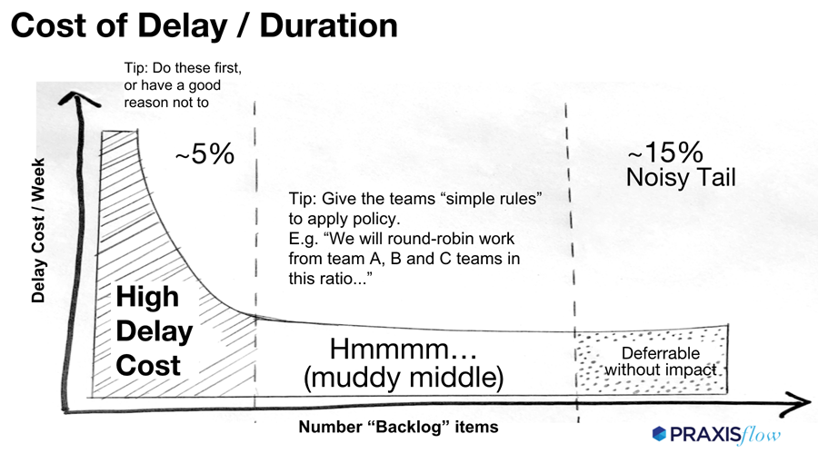

Slide 9
Highest Cost of Delay Items
“Gold”
What goes in this grouping?
Work that has the highest cost of delay relative to other work
Typically about 10% of your work will be in this group
Define you policy for these items, for example “Delaying starting these items within the next three month is unacceptable”
Our Policy for things in gold are:

Slide 10
Moderate Cost of Delay Items (and possibly a missed Gold item)
“Muddy Middle”
What goes in this grouping?
Work that you don’t think is “Gold” and moderate cost of delay relative to other work
Typically about 75% of your work will be in this group
Define you policy for these items, for example “We know we would choose any “Gold” work before these”
Our Policy for things in blue are:

Slide 11
Tail Cost of Delay Items
“Tail”
What goes in this grouping?
Work that you would
Typically about 15% of your work will be in this group
Define you policy for these items, for example “We have skipped these before, and these have an unclear or near zero cost of delay”
Our Policy for things in green are:

Slide 12
NOT ORDERED OR GROUPED YET

Slide 13
Chest Pain
Patient is 48y/o male with a family history of heart trouble. Patient just arrived from a hot-dog eating competition.

Slide 14
Broken Arm (suspected, swollen)

Slide 15
Broken Arm (compound, bent)

Slide 16
Fever 102F in 7 yo

Slide 17
Ingrown Toenail

Slide 18
Burn of hand (severe)

Slide 19
Rash on back 3 y/o

Slide 20
Cut, bleeding controlled

Slide 21

https://www.ahrq.gov/sites/default/files/wysiwyg/professionals/systems/hospital/esi/esihandbk.pdf

